Slide 1
VOCABITLARY:
USING BITS TO BUILD VOCABULARY
Class
Date

Slide 2
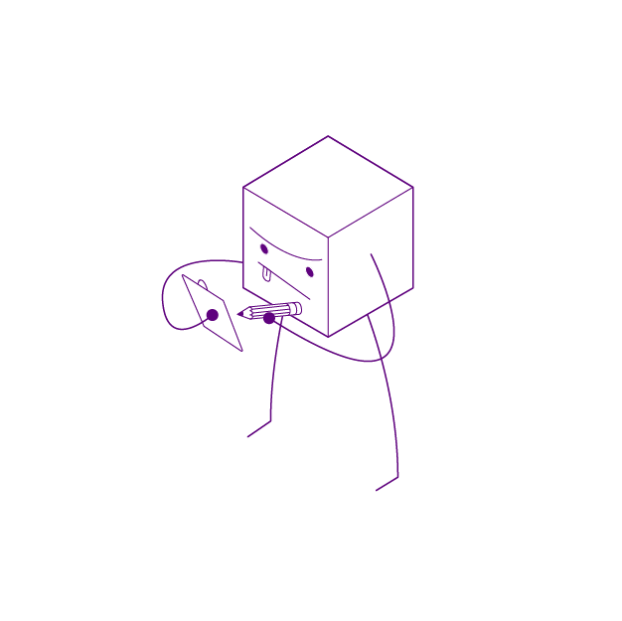
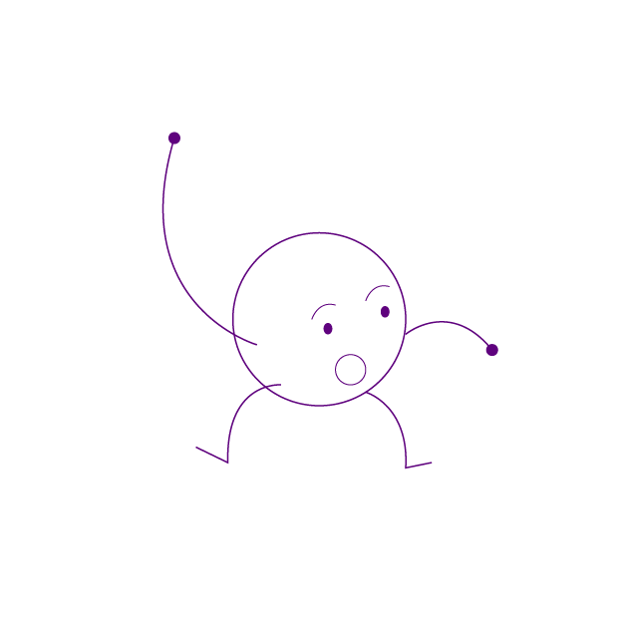
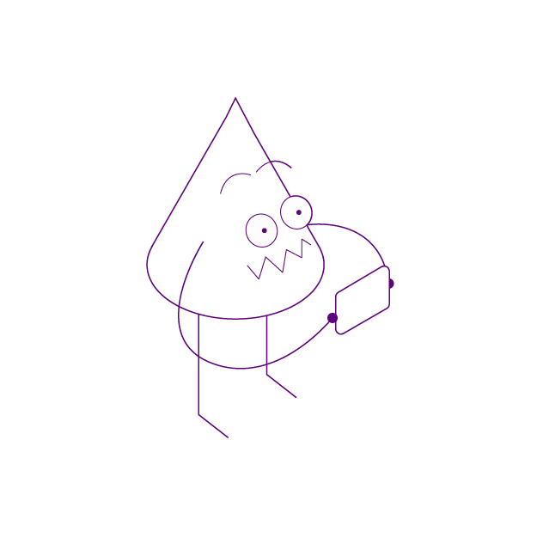
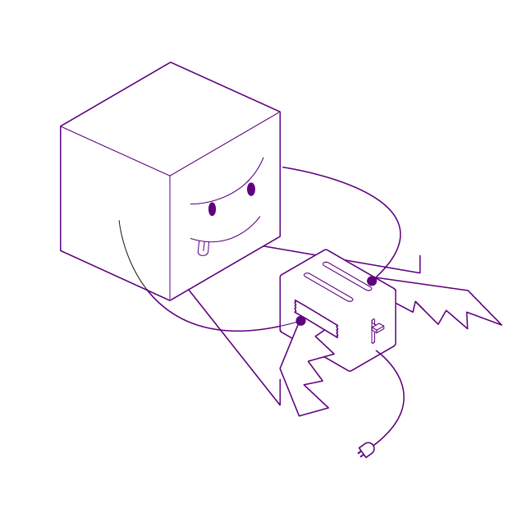
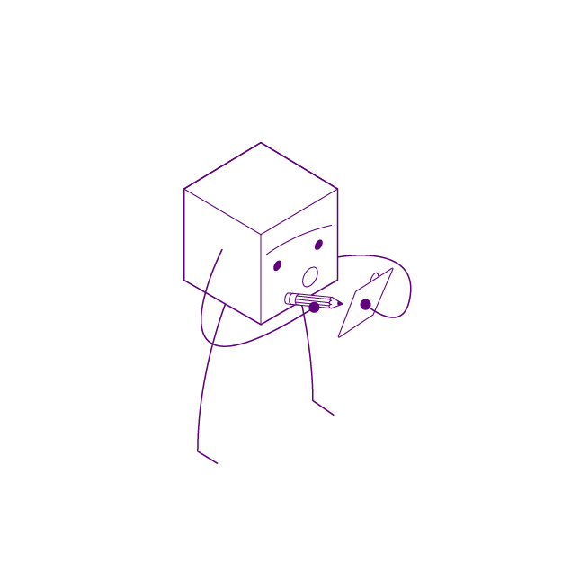
NOTES:
This presentation overviews the VocaBitlary lesson for 2 days of instruction (50 minute periods). You can customize the deck to reflect the needs of your individual learners and environment. Feel free to use the images below!

Slide 3
DAY 1
INTRO, CREATE, PLAY

Slide 4
TODAY WE WILL
Learn new vocabulary words!
Explore how we practice these words using physical and visual representations.
Build objects that represent our new vocabulary words using littleBits
Pair with another group and share your project for feedback.

Slide 5
INTRO
What strategies do you use to learn new vocabulary words?
How can it be effective to demonstrate word meaning through artistic representations?

Slide 6
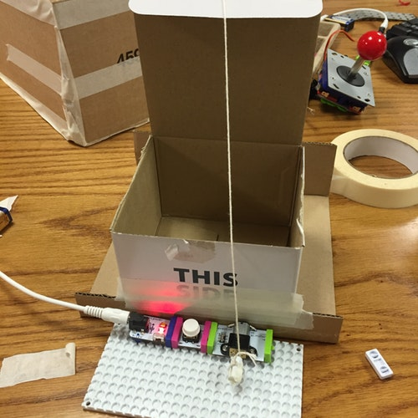
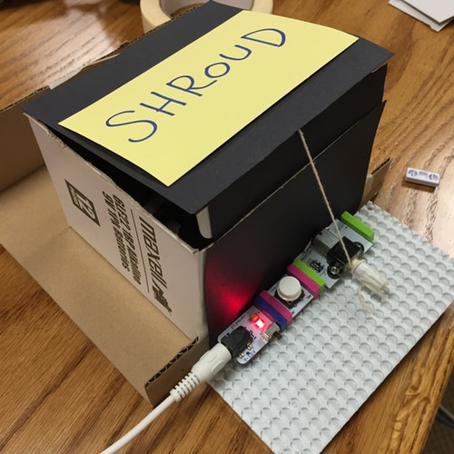
EXAMPLE
Shroud: Something that covers, screens, or guards.

Slide 7
OUR CHALLENGE
Use littleBits and assorted craft materials to build an object that demonstrates your understanding of a new vocabulary word and its definition.

Slide 8
USING THE INVENTION CYCLE
CREATE: In groups, build your word object.
PLAY: Pair with another group and share your ideas and design.
REMIX: Enhance your project based on peer feedback.
SHARE: Gallery Walk and project presentations.

Slide 9
OUR LEARNING TARGETS
Demonstrate understanding of new vocabulary words and their definitions.
Design a unique object to represent and show understanding of new vocabulary.

Slide 10
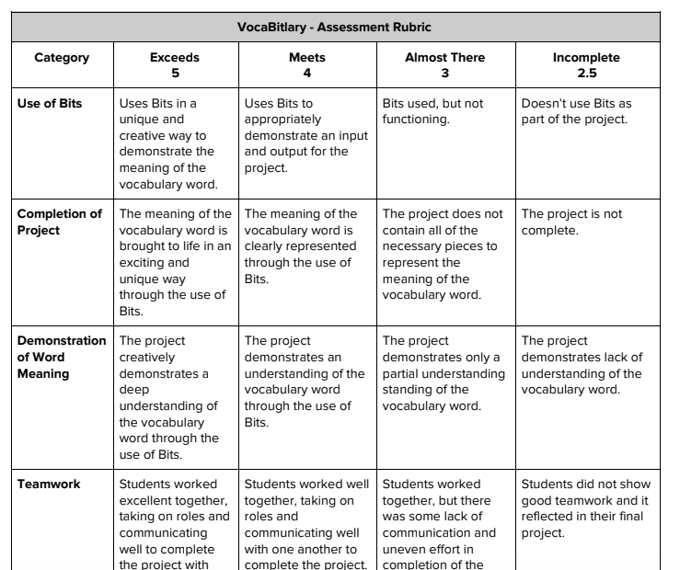
PROJECT EXPECTATIONS
Follow the Assessment Rubric handout to make sure your project exceeds expectations!

Slide 11
VOCAB LIST
INSERT VOCABULARY LIST HERE -

Slide 12
CREATE (25 MINS)
Work with your group to build your prototype.
How will you use your Bits to represent the meaning of your word? Get creative!
Test out the circuit to see if it works!

Slide 13
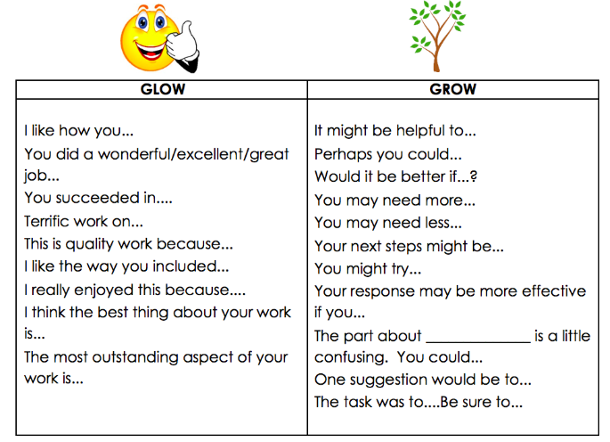
PLAY (10 MINS)
Use the “Glow and Grow” feedback process within your group

Slide 14
CLOSE
Cleanup:
Return any tools or craft materials to their designated space and clean up your workstation!
Put your project in the designated area to be stored until tomorrow.

Slide 15
DAY 2
REMIX, SHARE

Slide 16
DAY 2: TODAY WE WILL
Remix: Make improvements to your project based on peer feedback.
Share: Showcase our inventions through a Gallery Walk and project presentations.

Slide 17
REMIX (20 MINS)
Take that helpful feedback from your peers and enhance your work!

Slide 18
SHARE (15 MINS)
Let’s Gallery Walk!
Place your project on your desk for the class to see!
As you go around, can you guess your classmates words before they reveal them?
One person from your team should remain with your word invention while the other walks around and observes other’s work. When the timer is up, switch!
Presentations
What was your word? What is the definition of that word?
How did you use Bits to represent the word and it’s meaning?

Slide 19
CLOSE
Discussion:
How can we use artistic strategies to learn new vocabulary?
What new words did you learn today?
Cleanup:
Return any Bits to the box

